Slide 1
GENERAL ASSEMBLY
DS PROJECT 3
Thread Classification
27 May 2022

Slide 2
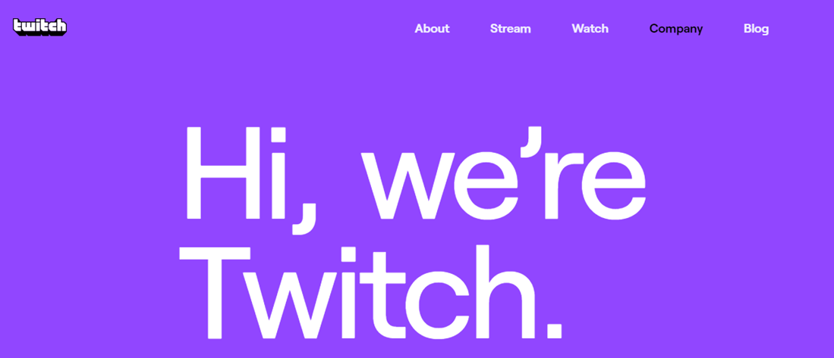
WHO ARE WE
Data Science Team
- Calvin, Joseph, Nelson, Zhi Hong, Priscilla
Notes:
sss

Slide 3

TABLE OF CONTENTS
01
02
03
04
PROBLEM
DATA OVERVIEW,
CLEANING &
VISUALIZATION
MODELING
LIMITATIONS &
FUTURE PLANS
RECOMMENDATIONS
& CONCLUSIONS

Slide 4
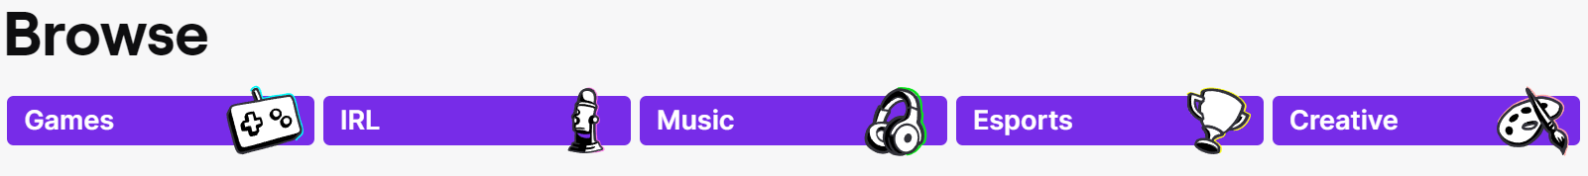
Problem
New single beta forum for gamers to post discussions & comments
High traffic of posts & comments updates daily
Challenging for:
Business development / marketing team to design sales & marketing campaigns that best meet the user’s needs
Users sieve through multiple posts to find topics that interest or are relevant to them → Poor user experience

Slide 5
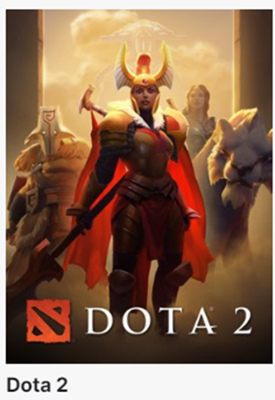
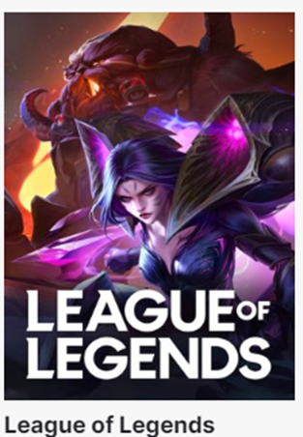
Top 2 Popular Games

Slide 6
Problem Statement
Use Reddit posts from Dota 2 and League of Legends to build a text classifier with an accuracy of at least 85%
Categorize the games in new forum
Identify top 5 predictors for each game
[r/DotA2, r/leagueoflegends]

Slide 7
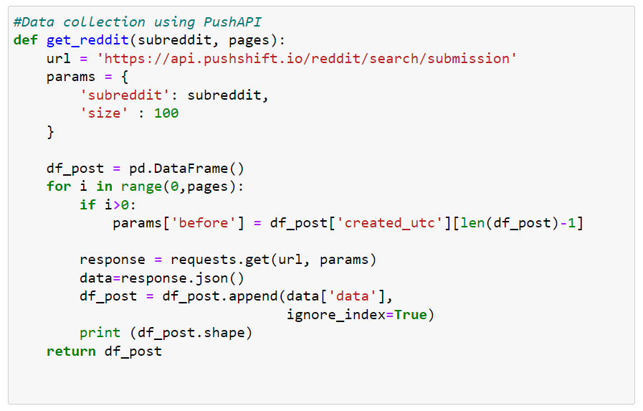
DATA Scraping
Data Collected from:
r/DotA2
r/leagueoflegends
Using pushshift API
Dota2 : 4000 rows, 88 columns
Lol : 4000 rows, 82 columns

Slide 8
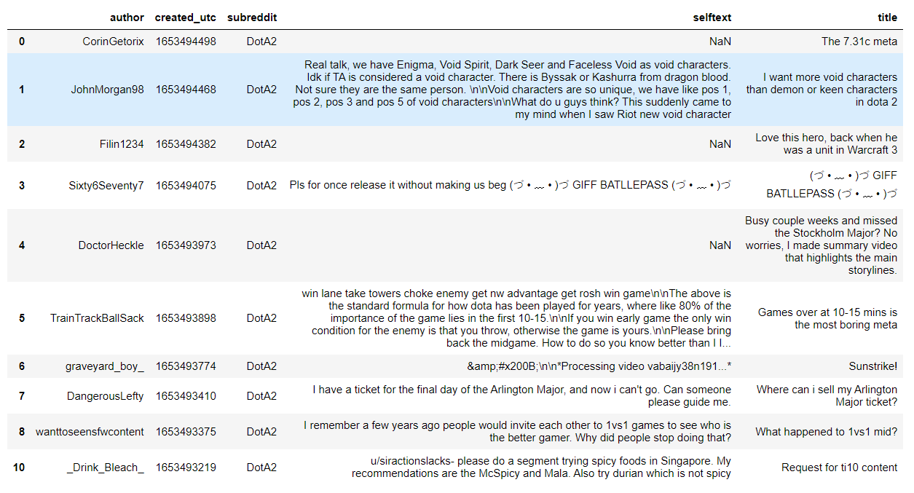
Data Outcome

Slide 9
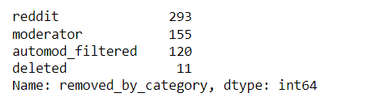
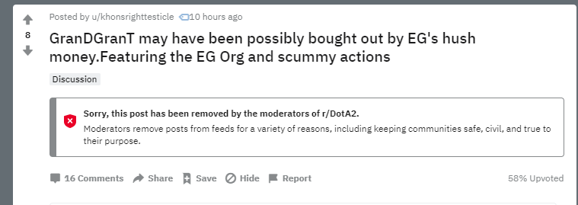
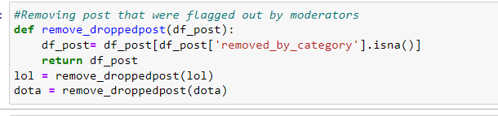
Data Cleaning
Check for duplicated post using the ID columns
Dropped posted that were removed by moderators
Filter out subreddit, selftext and title columns
Merged dataframe

Slide 10
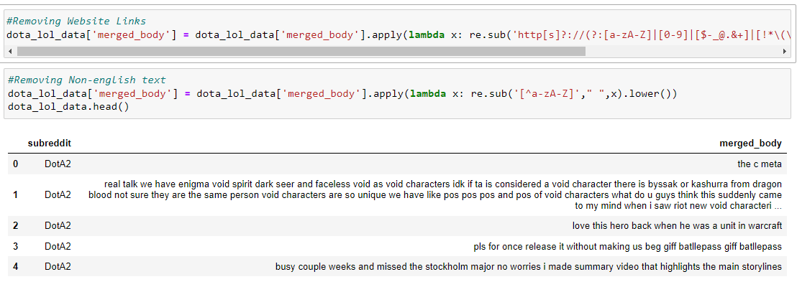
Data Cleaning
Other Data Cleaning
Replaced null values with white spaces
Merged self-text and title columns
Removed Website Link
Removed non-english text
Removed punctuations

Slide 11
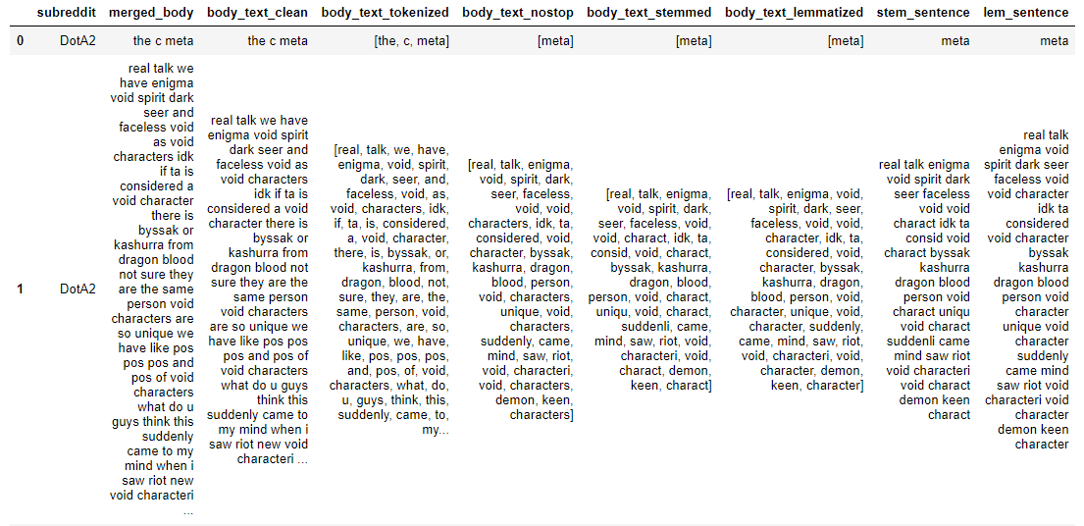
Data Cleaning
Tokenized the text
Stopword removal
Lemmatization

Slide 12
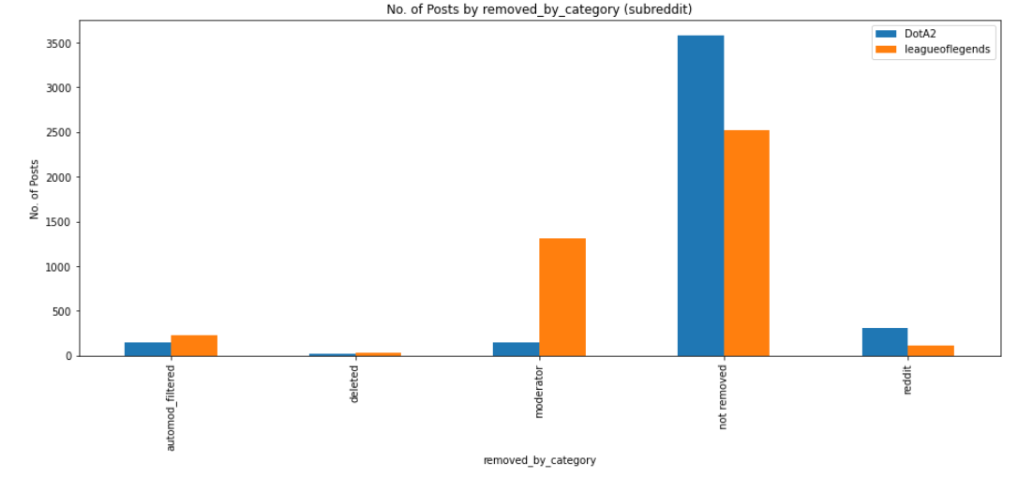
Visualisations of ‘Not Removed’ Posts
DotA2 subreddit contains 3580 posts
League of Legends subreddit contains 2526 posts
After merged, DotA2 (59%) vs League of Legends (41%) posts proportion
Notes:
Thanks Zhi Hong for the explanation! So after we clean the datasets, we observe there are posts that are either removed by reddit moderators ore deleted. Thus, we will pick only posts that are not removed. So Dota 2 contains 3500 posts while league of legends contains 2500 posts. After merging, Dota2 has 59% posts proportion comparing to League of Legends (41%) which are still quite comparable and good for analysis. Next, we will move on to the EDA part which is the top most frequent words from each subreddit

Slide 13
Vectorizers to generate word counts
Vectorizers | n-gram
Count Vectorizer | 1-gram, 2-grams
TF-IDF Vectorizer | 1-gram, 2-grams
Notes:
We utilise Vectorizers to transform texts to numerical/vectorial representation for running machine learning models specifically for Natural Language Processing (NLP).
Count Vectorizer is a way to convert a given set of strings into a frequency representation. In other words, it gives information of the number of times a particular word occurred in that document
TF-IDF is also count vectorizer but it includes extra weightage to emphasise on the feature importance of a particular word to a document
1 gram means that it will analyse the text word by word while 2-grams will analyse per 2 words

Slide 14
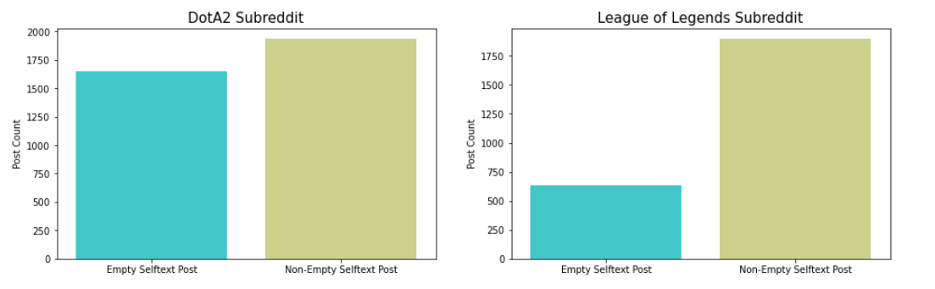
Visualisations of ‘Empty’ vs ‘Non Empty’ Selftext
More non-empty selftext posts
More text to analyse -> better indicator to analyse

Slide 15
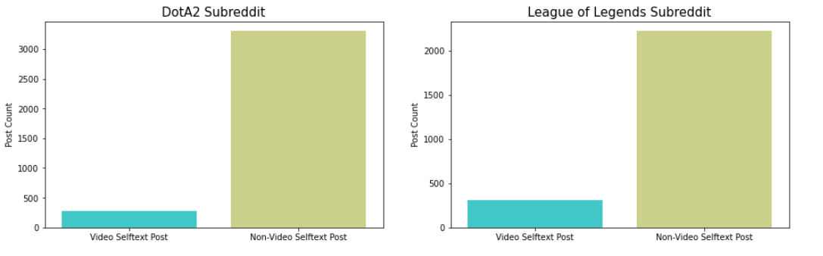
Visualisations of ‘Video vs Non-Video’ Selftext Posts
More non-Video Selftext Posts
Subreddits are good to go!

Slide 16
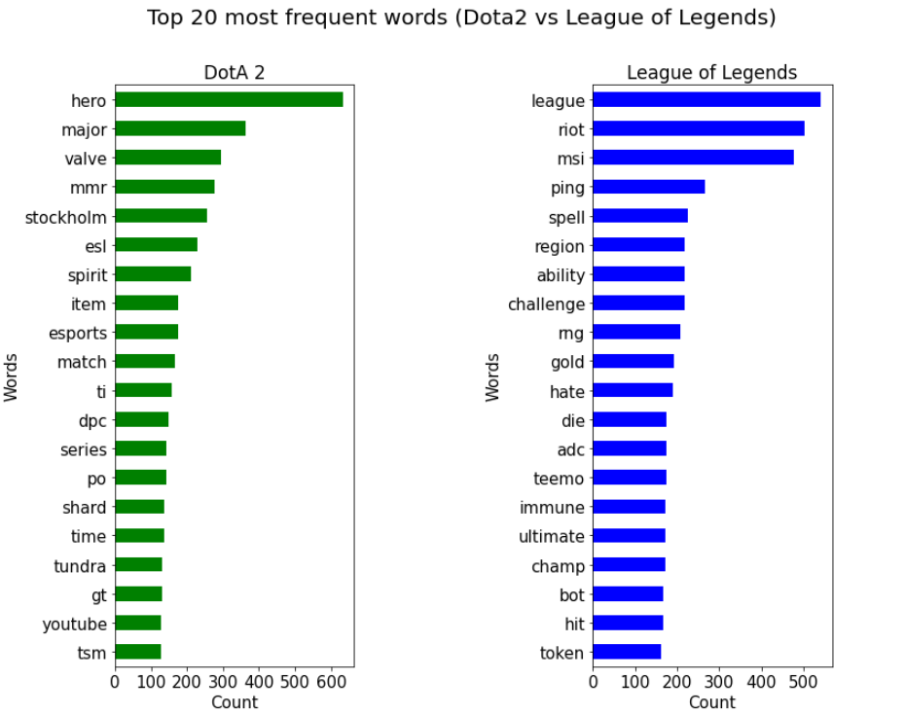
Data Visualisation - 1-gram Count Vectorizers
DotA2
Centers around tournaments, e.g. ESL Stockholm, happened 12 - 22 May 2022
TI (The International) & DPC (Dota Pro Circuit) refers to the top tournaments and placements for top teams
MMRs - ranked match discussions
League of Legends
Centers around gameplay & game highlights as there are more discussions on ability, challenge, spell, ultimate, immune
Strategy talks as shown in the word adc (Attack Damage Carry) and bot (Bottom lane)
Both game publishers (Valve for Dota2 and Riot for League of Legends) are in the top words list which is expected.
Surprisingly, only 1 hero is in the list.
Notes:
First, we will start with count vectorizers..
Dota2 subreddit
- Subreddit generally centers around competition, as seen from the word Stockholm, referring to ESL one in Stockholm happened 12 May -22 May 2022
- Also, TI(The International) and DPC (Dota Pro Circuit) refer to the top competitions and placements for top teams
- MMRs are also the top words as people talk about their own ranked matches or pro players rank matches
League of Legends subreddit
- Subreddit centers around gameplay and game highlights as people talk about ability, challenge, spell , ultimate.
- The community talks a bit of strategy as shown in the word adc (Attack Damage Carry) which refer to the role they play and bot (Bottom lane) which refers to the lane in the map.
Both games publisher (Valve for Dota2 and Riot for League of Legends) are in the top words list which is expected.
Surprisingly, only 1 hero is mentioned in the list

Slide 17
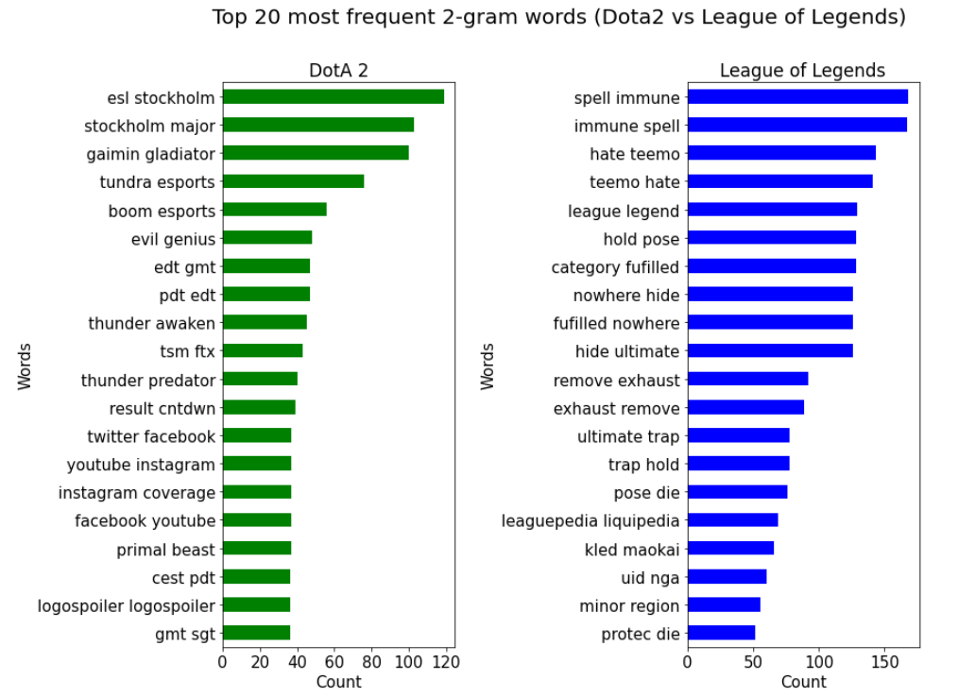
Data Visualisation - 2-grams Count Vectorizers
DotA2
Similar to 1-gram, subreddit focuses on tournaments discussions (ESL Stockholm and Stockholm majors).
More esports teams are mentioned:
Gaimin Gladiator
Tundra Esports
Boom Esports
Evil Genius
TSM FTX
Several time zones are mentioned
Social media coverage
Primal Beast (newest born hero)
League of Legends
Similar to 1-gram, subreddit focus on gameplay through spell immune, hide ultimate, remove exhaust
Head to head top lane heroes (Kled and Maokai)
Notes:
For 2-grams, we observe there are more contexts of words that we can understand
So for DotA2 subreddit
It also focuses on competition talks (ESL Stockholm and Stockholm Majors). On top of that, we noted more esports teams are mentioned, such as:
1. Gaimin Gladiator
2. Tundra Esports
3. Boom Esports
4. Evil Genius
5. TSM FTX
- Several time zones are also mentioned in the top list. However, as digits are removed through data cleaning, the time zones are next to each other. This could potentially give insights on the timezones the users are in and also the tournament start time through different time zones
- Additionally, there are more Social media coverage (instagram facebook youtube) as part of competition broadcast or platforms that are popular for dota2
- We also noted Primal Beast which is a newest born hero that was recently launched by Dota2 (2022 23rd Feb) and it’s still one of the hot heroes for discussion
For league of legends subreddit,
It is Similar to 1-gram whereby it focuses on gameplay which can be seen by the words spell immune, hide ultimate, remove exhaust
- For heroes, only Head to head top lane heroes (Kled and Maokai) are often being discussed

Slide 18
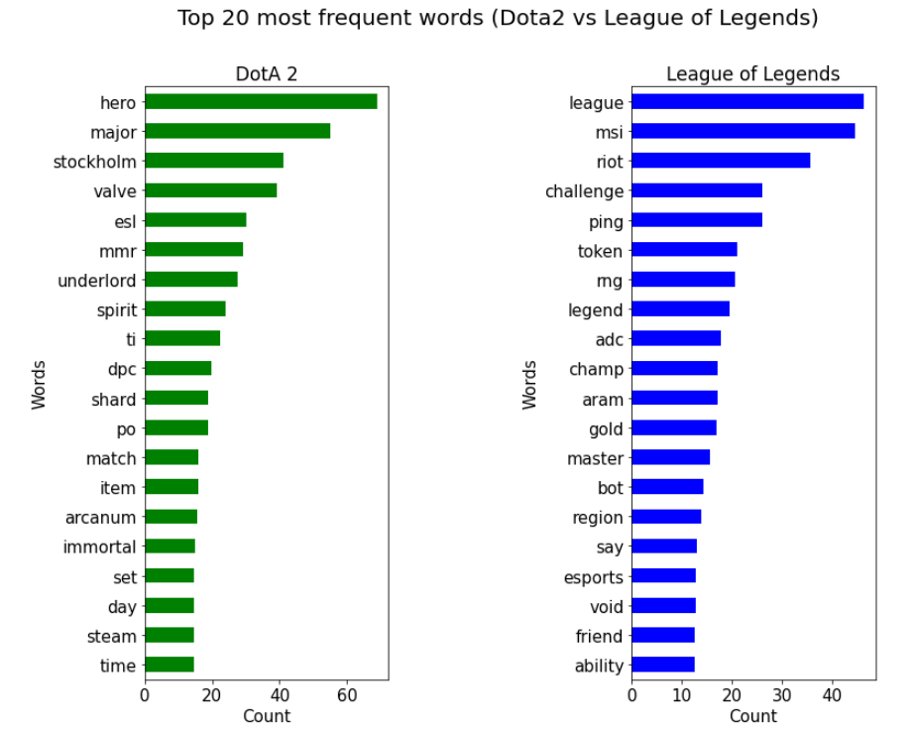
Data Visualisation - 1-gram TF-IDF Vectorizers
DotA2
DotA2 centers around tournament talks
More emphasis/weightage on items,e.g. Arcanum and immortal as item rarity level
League of Legends
Similar to Count Vectorizers, League of legends community discusses about gameplay, ability and strategies
Notes:
Moving on to TF-IDF vectorizers, outline is, dota2 still revolves around tournament talks and league of legends still revolve around gameplay. However, for dota2, there are more emphasis or importance on items and items rarity level. Also, observed 1 more hero made to the list

Slide 19
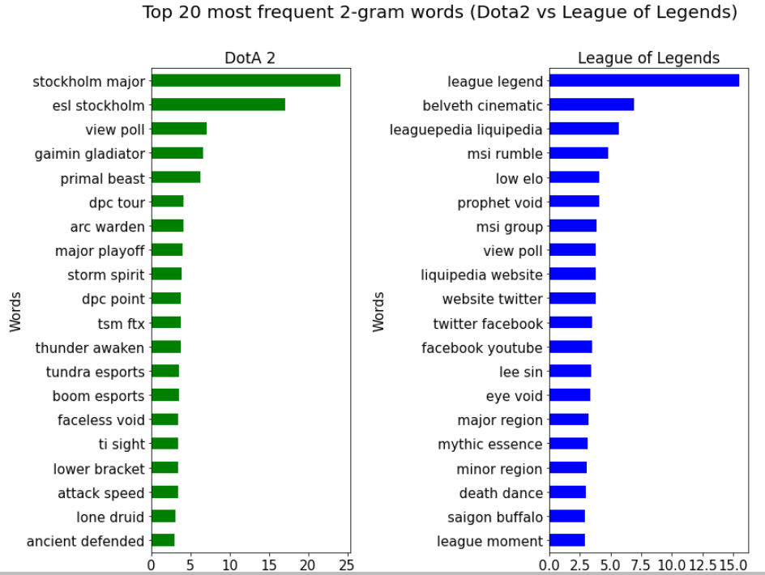
Data Visualisation - 2-grams TF-IDF Vectorizers
DotA2
DotA2 centers around tournament talks and teams
Notably observed more topics on hero names e.g. Arc Warden, Storm Spirit, Faceless Void, Lone Druid, which is more unique to the game
League of Legends
There are new topics with more weightage on hero names, e.g. Prophet Void, Eye Void, Lee Sin, Belveth cinematic
Tournament jargons (Saigon Buffalo, MSI rumble)
Notes:
For 2 grams for dota 2, on top of the tournament talks, all the 2-word heroes came out to the list, which means that those heroes the are more important features in dota2. Similarly for league of legends, we observe more hero names made to the list.

Slide 20
Count Vectorizer vs TF-IDF Vectorizer (DotA2)
DotA2
Count Vectorizer |  | TF-IDF Vectorizer
1-gram | 2-grams | 1-gram | 2-grams
Tournaments (ESL, TI, DPC) MMRs - ranked match discussions | Tournaments (ESL Stockholm and Stockholm majors) Esports teams (Gaimin Gladiator, Evil Genius, etc) | Tournaments (ESL, TI, DPC) Items and items rarity level (Arcanum and Immortal) | Tournaments (ESL, TI, DPC) Hero names (Arc Warden, Storm Spirit, Faceless Void, Lone Druid)
Notes:
To sum it up, for dota2, key differences are highlighted yellows whereby things that are more unique to each of the subreddit made it to the list. In this case it’s the item rarity levels and hero names as opposed to MMRs which exists on both Dota 2 and league of legends and esports team names as team names can be the same across dota2 and league of legends so that probably reduce the importance of those words

Slide 21
Count Vectorizer vs TF-IDF Vectorizer (League of Legends)
League of Legends
Count Vectorizer |  | TF-IDF Vectorizer
1-gram | 2-grams | 1-gram | 2-grams
Gameplay (ability, challenge, spell, ultimate, immune) Strategy talks (Attack Damage Carry) and bot (Bottom lane) | Gameplay (spell immune, remove exhaust, ultimate trap) Head to head top lane heroes discussion (Kled & Maokai) | Gameplay (ability, challenge, spell, ultimate, immune) Strategy talks (Attack Damage Carry) ,bot (Bottom lane) | Hero names (Prophet Void, Eye Void, Lee Sin, Belveth Cinematics) Tournament jargons ( Saigon Buffalo, MSI rumble)
Notes:
Similar for league of legends, instead of just the usual gameplay, tfidf put more emphasis on words that are more unique to each game, e.g. hero names and LOL tournament jargons

Slide 22
Model Building & Testing
Base Model
Logistic Regression
Random Forest
Multinomial Bay Naives
Count Vectorization
TFIDF Vectorization

Slide 23
Logistic Regression
Dota2
0.5
Likely LoL
Likely Dota2
League of Legends
Posts / Selftext

Slide 24
Logistic Regression (Train)
Count Vectorization
96.5%
TF-IDF Vectorization
96.9%

Slide 25
Logistic Regression (Test)
Count Vectorization
87%
TF-IDF Vectorization
89.6%

Slide 26
Random Forest Algorithm
X0, X1
X2, X3
X3, X4

Slide 27
Random Forest (Train)
Count Vectorization
99.4%
TF-IDF Vectorization
94.6%

Slide 28
Random Forest (Test)
Count Vectorization
89.51%
TF-IDF Vectorization
89.57%

Slide 29
Multinomial Naive Bayes
Step 1
Step 3
Step 2
Calculate the frequency of each discrete individual words in their respective category
For a given sentence, calculate and compare the probability of the sentence being classified as each of the respective category, given each of the sentence’s discrete words
Measure prior probability of the respective category, and the probability of each discrete words given the respective categories

Slide 30
Multinomial Naive Bayes (Train)
Count Vectorization
94.3%
TF-IDF Vectorization
96.3%

Slide 31
Multinomial Naive Bayes (Test)
Count Vectorization
90.2%
TF-IDF Vectorization
90.8%

Slide 32
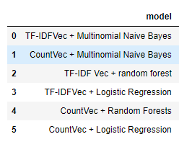
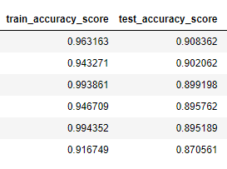
Test Results Overlook
Base Model : Logistic Regression
Best Model (Chosen): Multinomial Naive Bayes + TFIDF

Slide 33
Top 5 Predictors
Dota2
League of Legends
Hero
Valve
Major
MMR
Stockholm
Riot
Challenger
Champion
Adc
Aram

Slide 34
Top 3 Most Frequent Words in Misclassified Posts
Words |  |  | DESCRIPTION
Ping |  |  | In gaming ping refers to the delay between a players input and the servers response
Hero |  |  | Primarily refers to characters in Dota2. A lot of player base in LOL comes from Dota2 and refers to LOL champions as Heros
Discord |  |  | A popular group-chatting platform that is built for gamers to communicate in-game

Slide 35
Limitations & Future Plans
1) Model Accuracy Improvement
Some posts were misclassified e.g. ping, hero, discord
Better data cleaning steps e.g. remove Character Entities
2) Include New Model Features
Analyse moderated posts to implement auto regulation of potential user rogue behaviour e.g. profanities, spams
Sentiment analysis

Slide 36
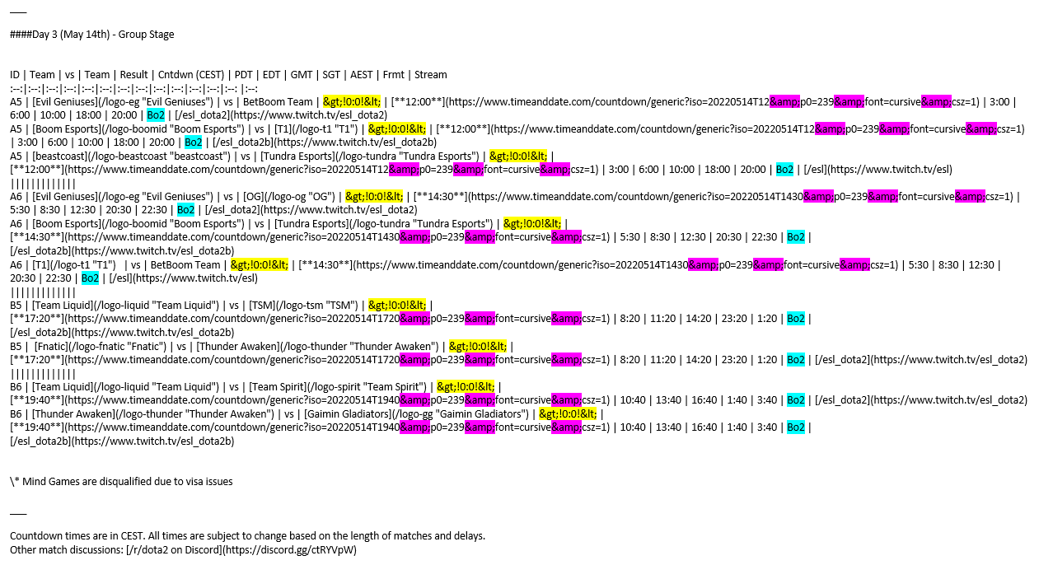
Limitations
Mode
SATURN
NEPTUNE
JUNE 2
OCTOBER 14
JANUARY 23
Neptune is the farthest planet from the Sun

Slide 37
Recommendations & Conclusion
Internal
1) Roll out classification to split posts into 2 separate threads
2) Establish timeline for future model features roll-out
3) Tease out campaign specific insights e.g. new users acquisition
External
1) Developers: Insights on sentiments, new games &/or features, etc.
2) Esports/Events: Insights on interests & mechanics, partnerships, etc.
3) Gaming Streamers: Insights on peak online user activities, etc.

Slide 38

THANKS!

